Slide 1
Trip Track
Travel Log -- Save and Show Your Journey

Slide 2
About Trip Track
Trip Track is currently a web app in development, it will eventually become a phone app. Trip Track is a travel log app. Users who join will be able to start tracking a trip that they go on for any length of time. During that trip, a user can post descriptions, photos, and ratings about different locations that they have visited. A log is kept for them to share if they want. The shared trips will eventually be visible for other users to duplicate.

Slide 3
The Beginning

Slide 4
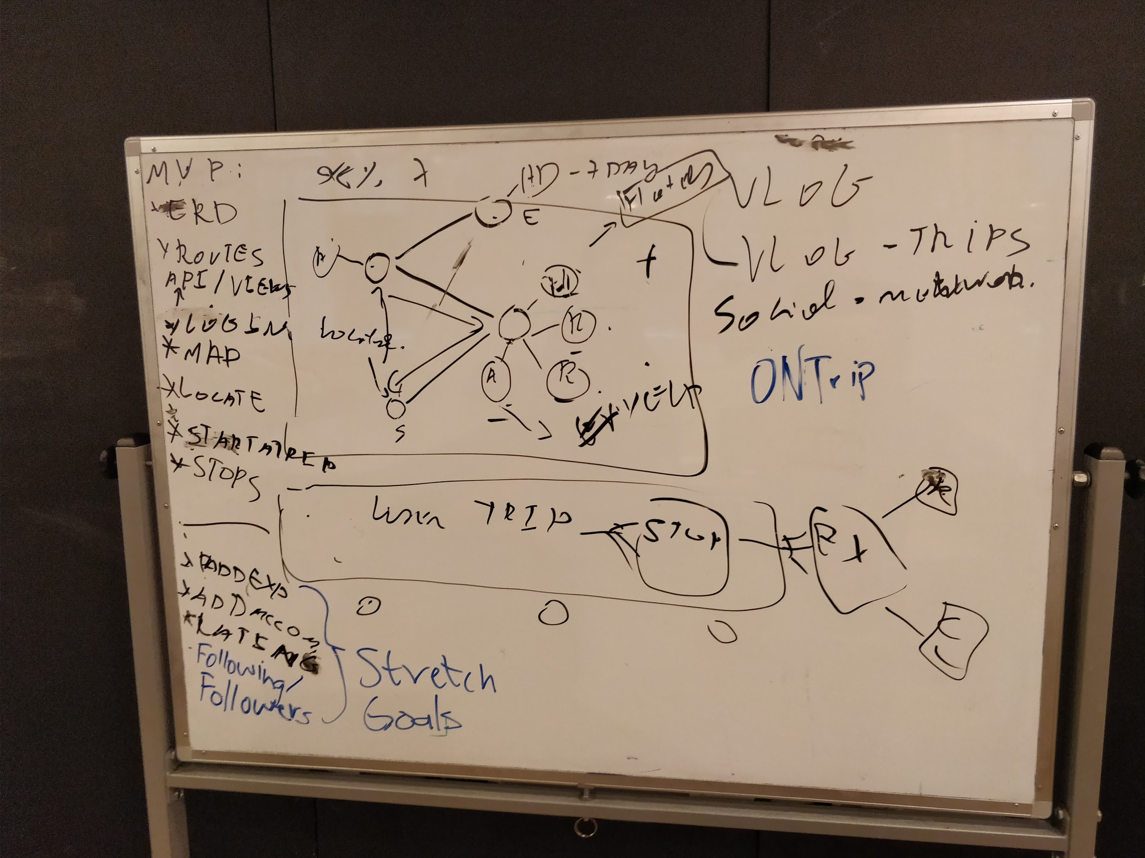
White Boarding

Slide 5
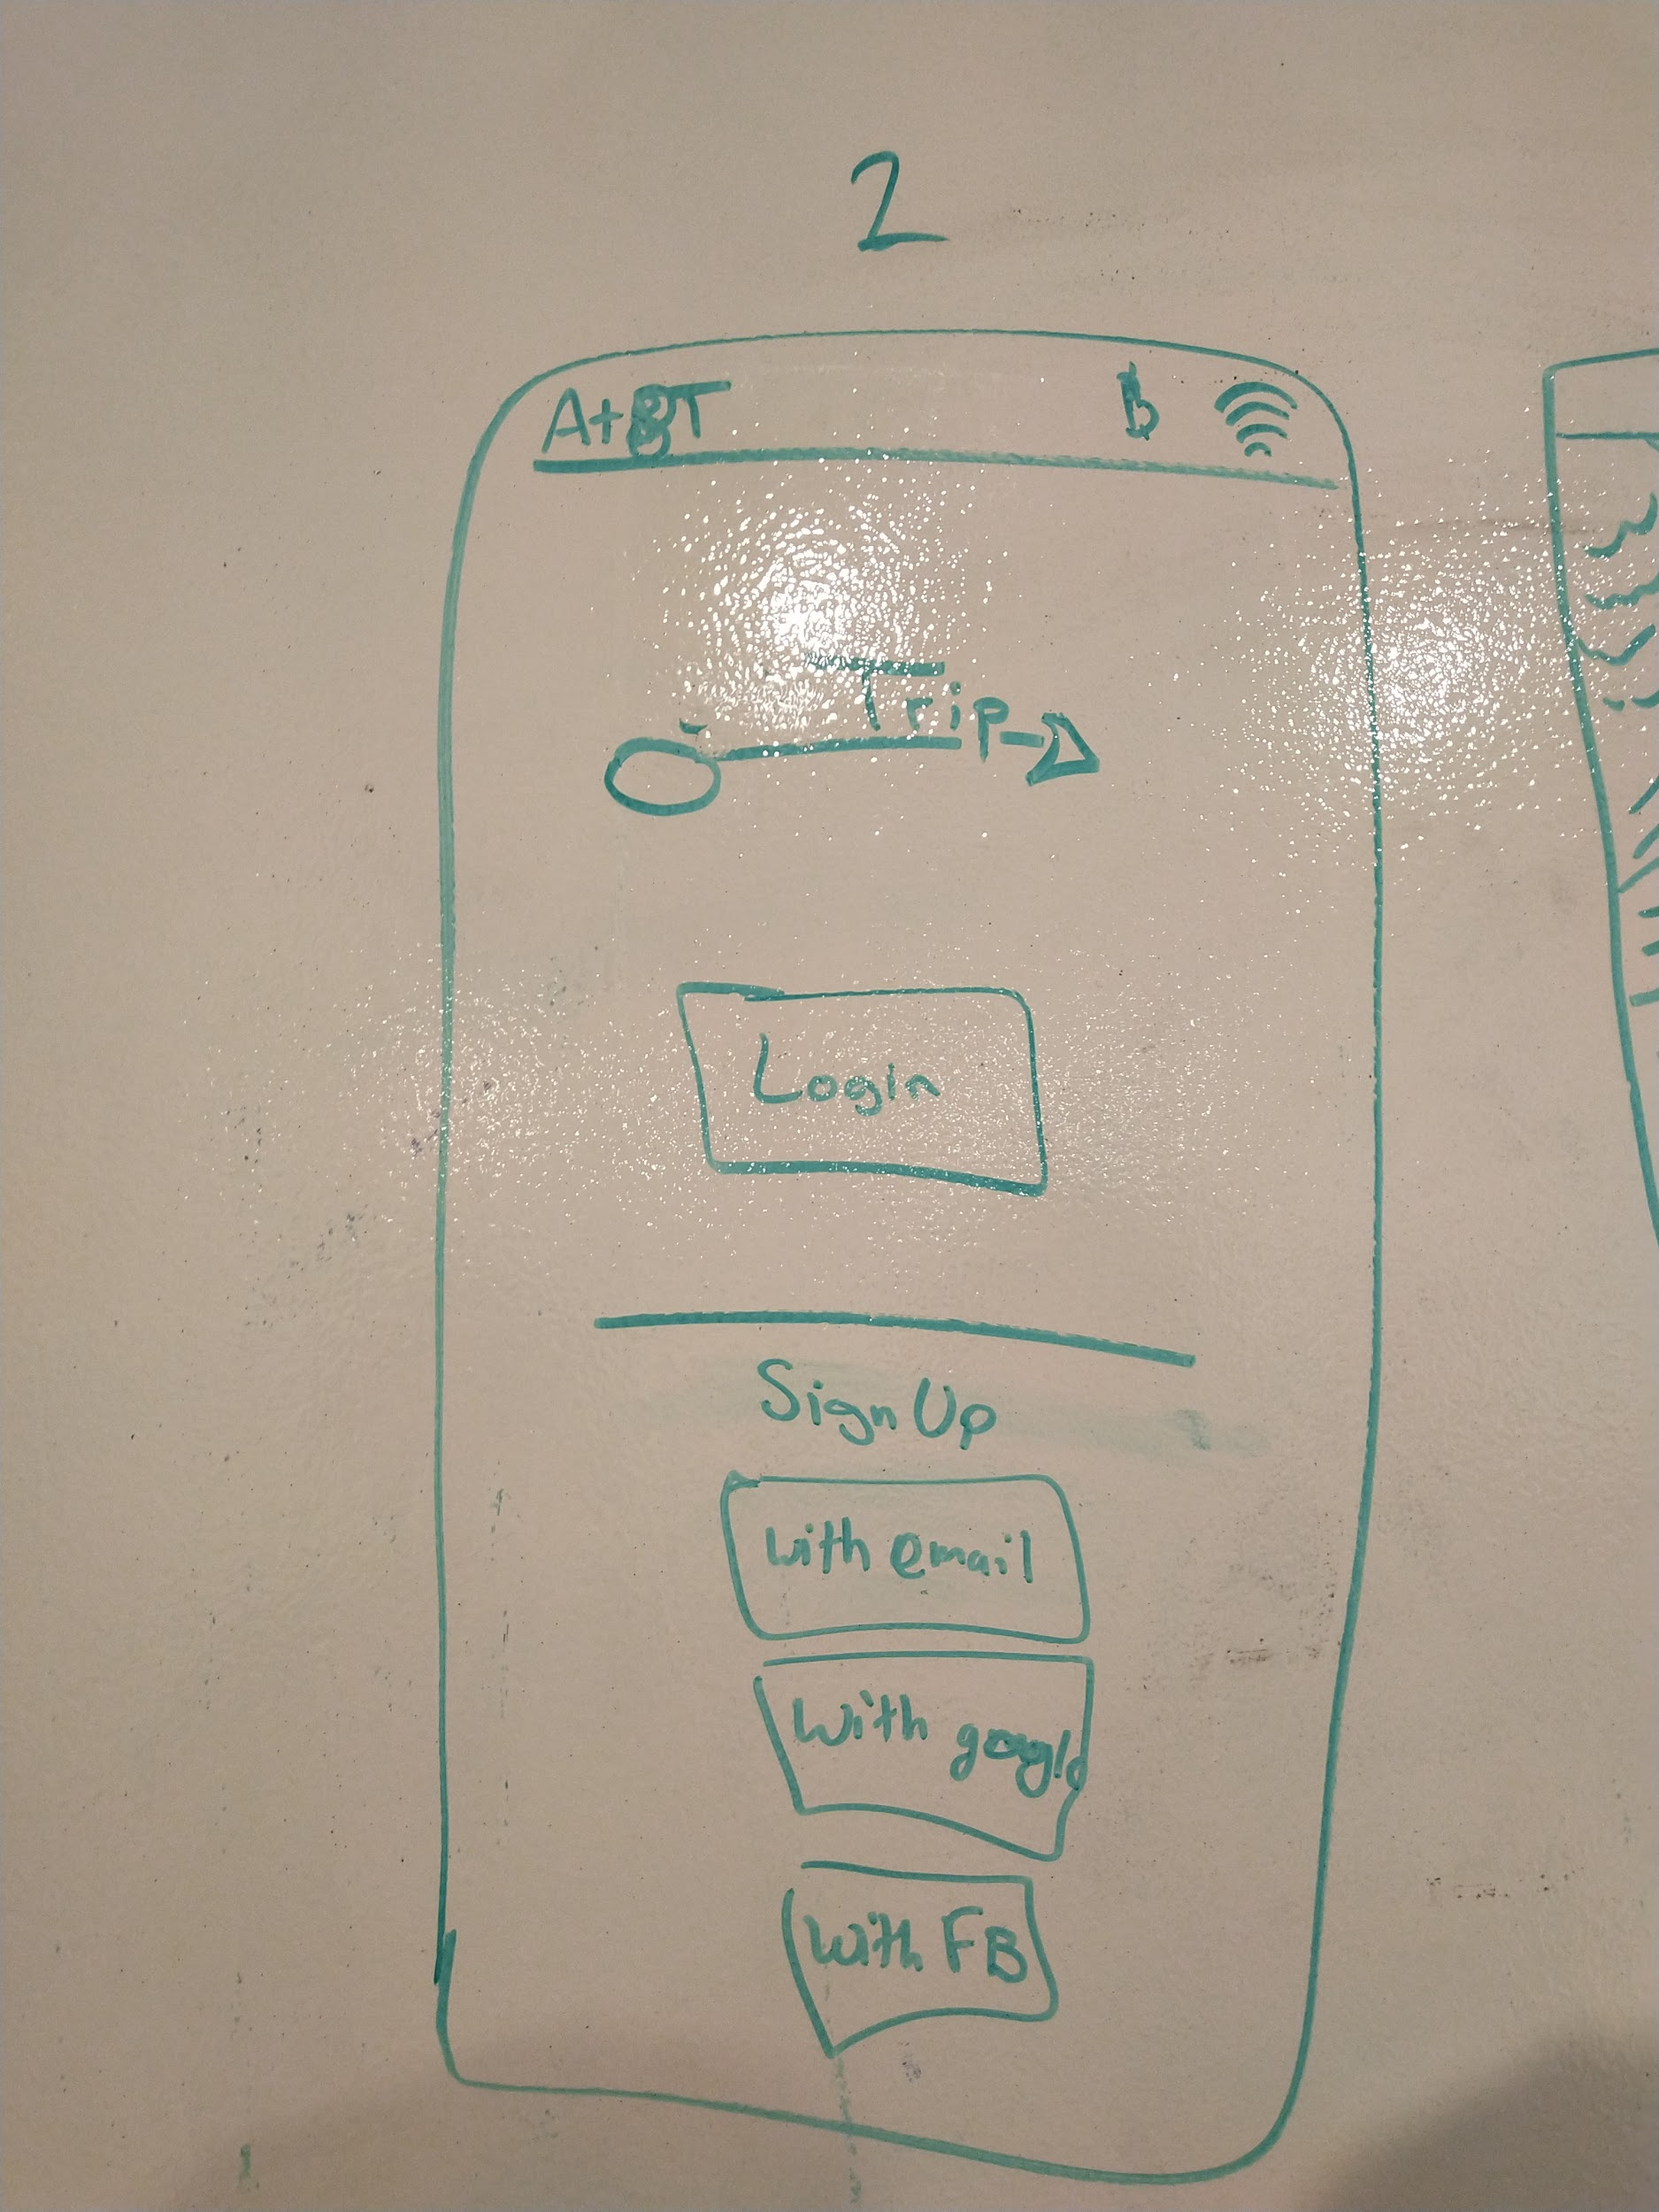
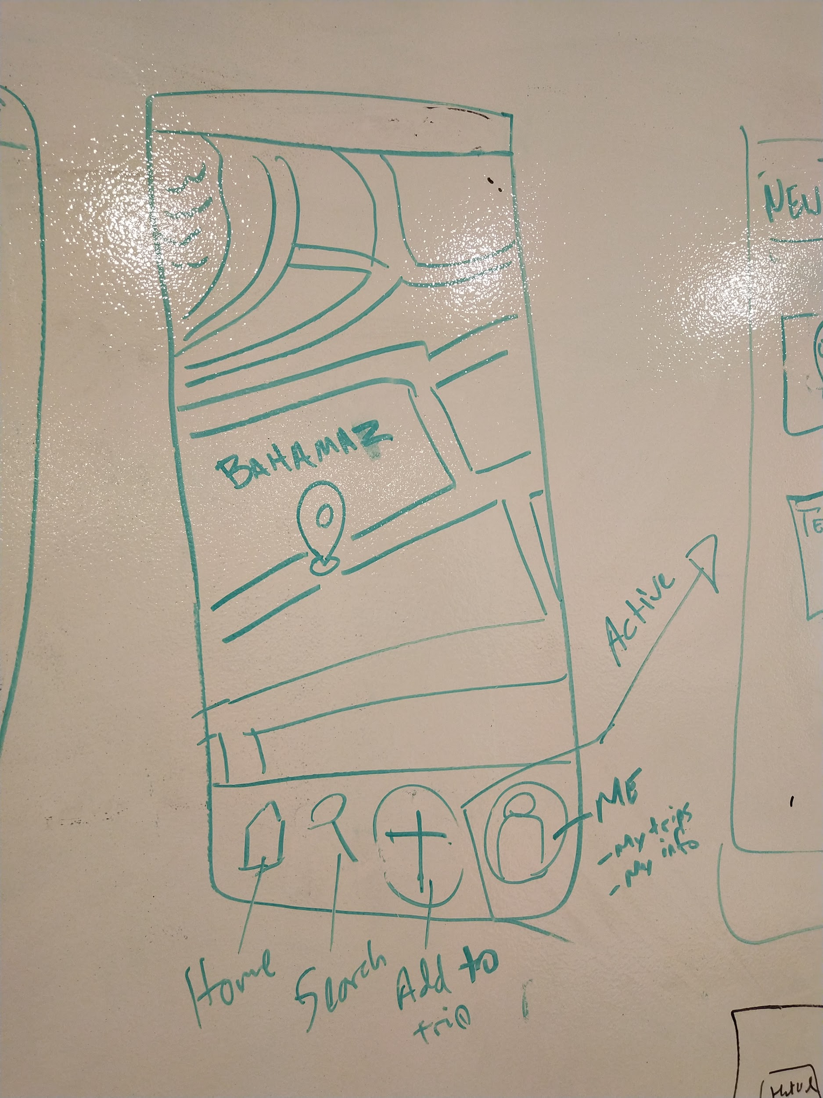
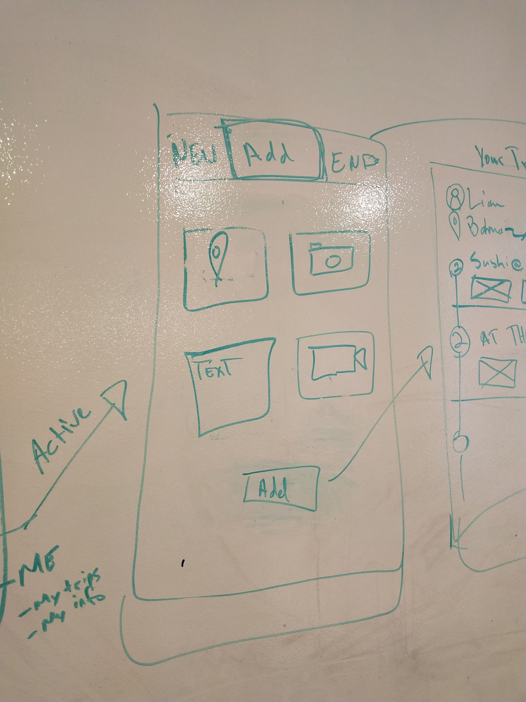
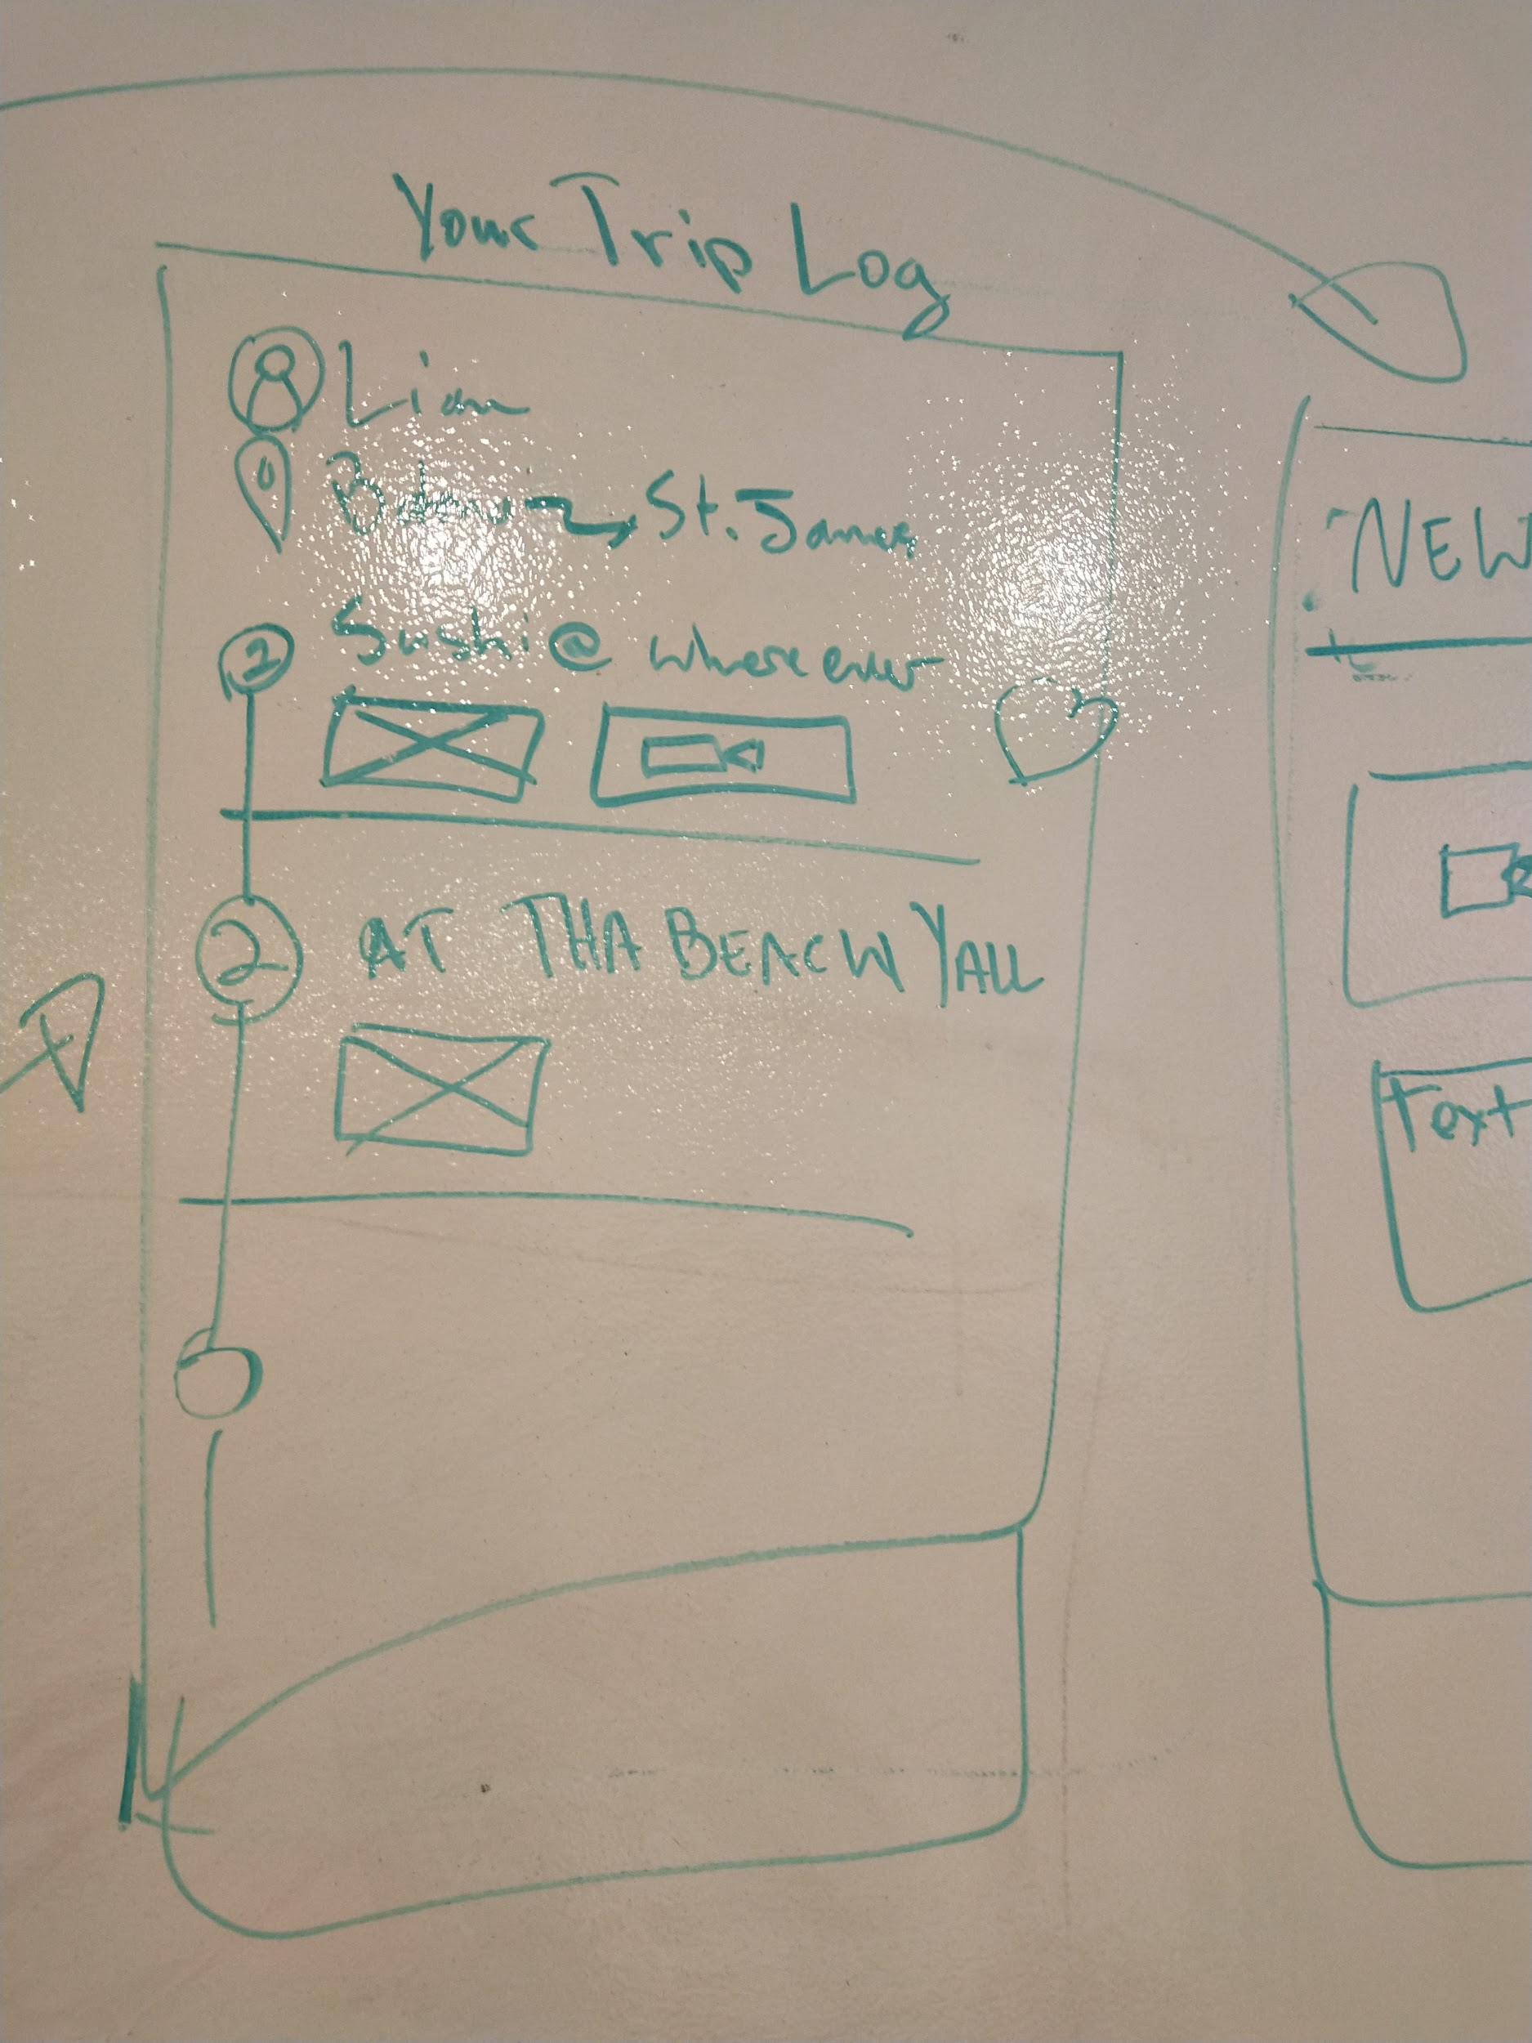
Then This...

Slide 6
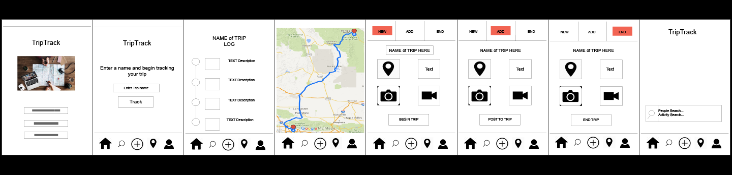
Turned into our: Wire Frames

Slide 7
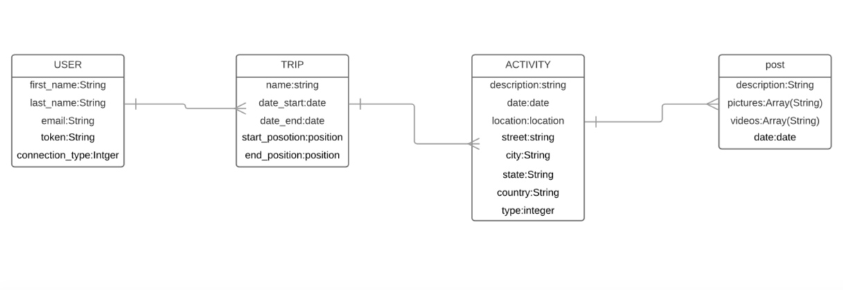
ERD

Slide 8
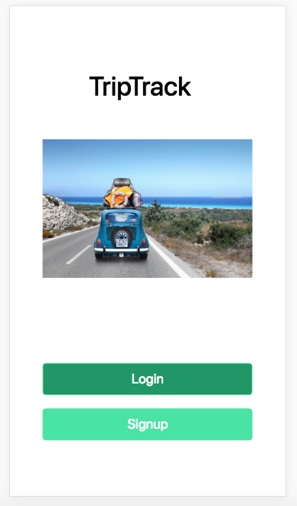
Typical Users
Jim, a 55-year-old retired employee is vacationing in Bahamas. He wants to make his trip memorable and share it with his family and friends.
Jennifer, a popular 16-year-old girl on social media, is running errands in San Francisco. She wants to show off her day trip to her friends.

Slide 9
Triumphs

Slide 10
Working together
Agreeing and collaborating on the idea, look, and functionality
Making Google Maps work
Making Google Search work
Bringing our idea of a travel log to fruition, user can sign up, log in, start a trip, post, and end the trip.

Slide 11
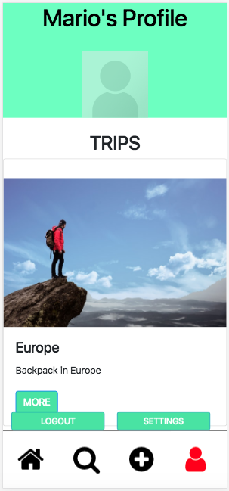
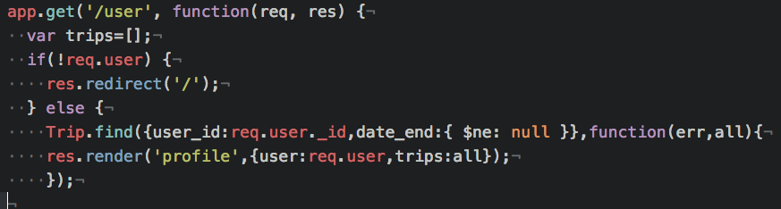
Mario

Slide 12
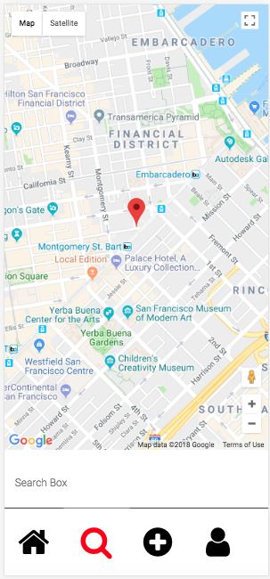
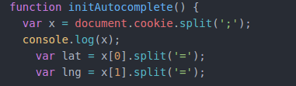
Felix

Slide 13
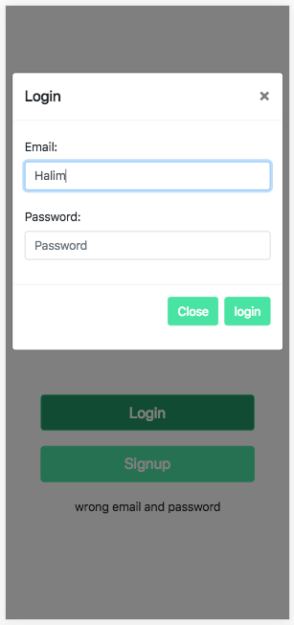
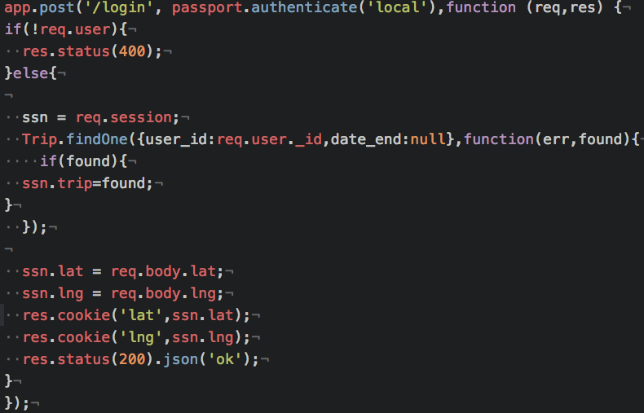
Halim

Slide 14
Challenges

Slide 15
Finding out the long and hard way that Body Parser does not handle multi-data parsing. Body Parser only parses text.
We ended up using Multer in conjunction with BP to allow image upload
Good practice working in a group of different skill levels
We asked a lot of questions and made sure the project mvp stayed realistic to the time frame.

Slide 16
Thank YOu!
Kay
Justin
Stephanie
WDI 43

